Slide 1
SMART STREET LIGHTING USING IBM WATSON
TEAMATES:-
SANDEEP REDDY
SAI KRISHNA
KUSHAL

Slide 2
Abstract:
Streetlights are among a city’s strategic assets providing safe roads, inviting public areas, and enhanced security in homes, businesses, and city centers. They’re usually very costly to operate and they use in average 40% of a city’s electricity spending. it’s becoming crucial that municipalities, highway companies and other streetlight owners deploy control systems to dim the lights at the right light level at the right time, to automatically identify lamp and electrical failures and enable real time control.
Based on the intensity levels we can change the intensity of the street lights from the User interface which is created in Node Red platform of IBM Watson services. We can even control all the street lights from that User interface.

Slide 3
HARDWARE COMPONENTS:-
*NODE MCU
*LDR
*LED
SOFTWARE COMPONENTS:-
*ARDUINO IDE
*ANDROID STUDIO
*IBM WATSON CLOUD SERVICES
SERVICES:-
*IOT PLATFORM
*NODE RED UI

Slide 4
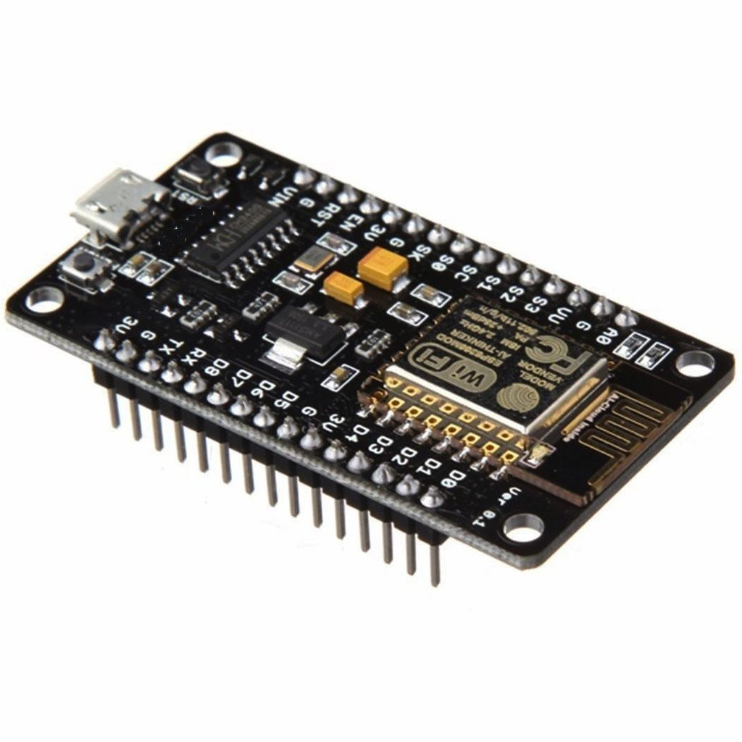
*NODE MCU:-
Node MCU is an open source IoT platform. It includes firmware which runs on the ESP8266 Wi-Fi SOC from Express if Systems, and hardware which is based on the ESP-12 module. The term "Node MCU" by default refers to the firmware rather than the development kits. The firmware uses the Lua scripting language. It is based on the elua project, and built on the Express if Non-OS SDK for ESP8266. It uses many open source projects, such as SPIFFS
As Arduino.cc began developing new MCU boards based on non-AVR processors like the ARM/SAM MCU and used in the Arduino Due, they needed to modify the Arduino IDE so that it would be relatively easy to change the IDE to support alternate toolchains to allow Arduino C/C++ to be compiled for these new processors..

Slide 5
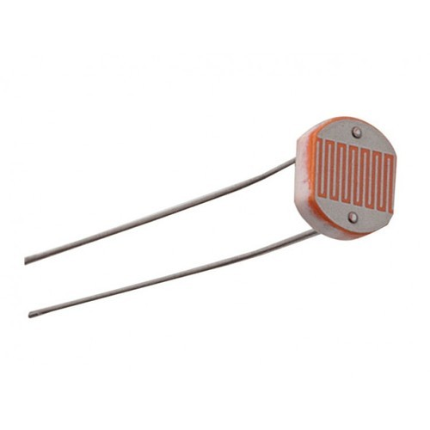
*LDR SENSOR :-
A photoresistor (or light-dependent resistor, LDR, or photo-conductive cell) is a light-controlled variable resistor. The resistance of a photoresistor decreases with increasing incident light intensity; in other words, it exhibits photoconductivity. A photoresistor can be applied in light-sensitive detector circuits, and light-activated and dark-activated switching circuits.

Slide 6
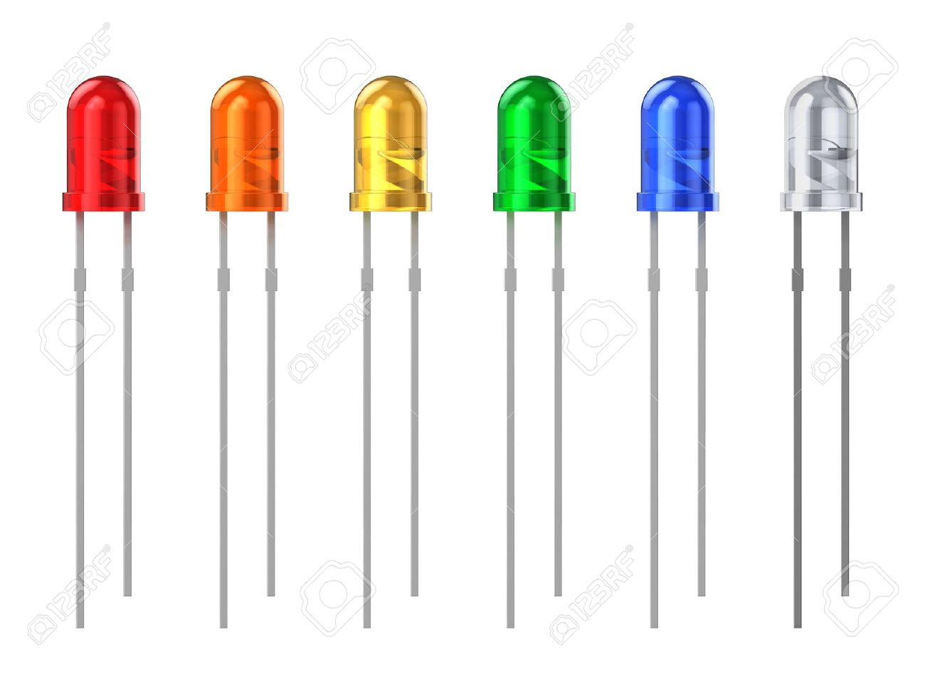
*LED’S:-
A light-emitting diode (LED) is a semiconductor light source that emits light when current flows through it. Electrons in the semiconductor recombine with electron holes, releasing energy in the form of photons. This effect is called electroluminescence .The color of the light (corresponding to the energy of the photons) is determined by the energy required for electrons to cross the band gap of the semiconductor. White light is obtained by using multiple semiconductors or a layer of light-emitting phosphor on the semiconductor device.

Slide 7
Block Diagram:
IBM CLOUD
LDR Sensor
INPUT
NODE MCU
(ESP8266)
LED’S
OUTPUT
MOBILE APP

Slide 8
OUTPUT:-
Individual and Area wise Street lights can be controlled using a single app.
If necessary, the required street lights can even be made dimmer using the mobile app.
Reduces Manual effort in controlling the street lights.

Slide 9
THANK YOU

